Slide 1

CLASS 8 : CSS GRID

Slide 2
Introduction: GRID
Grid Container and Grid Items : Just like Flexbox, Grid involves a parent element and its direct children.
Grid Container : The element that holds the grid. You create by setting “display: grid;”
Grid Items: The direct children of the Grid Container. They are automatically place into the grid cells.

Slide 3
The Anatomy of a Grid
Grid Lines: The dividing lines that make up the structure of the grid. They can be vertical (column grid lines) or horizontal (row grid lines). They are numbered starting from 1.
Grid Track: The space between two adjacent grid lines. This is a row (horizontal track) or a column (vertical track).
Grid Cell: The single unit of a grid, where a row and column intersect. It's like a table cell.
Grid Area: A rectangular area made up of one or more adjacent grid cells. You define it by specifying starting and ending grid lines.

Slide 4
Defining the Grid (Container Properties)
- grid-templates-columns & grid-template-rows
These properties define the number and sizes of the columns and rows in your grid.
Values:
Fixed units: px, rem
Fluid units: %, fr
The fr (fraction) unit: This is a powerful new unit created for Grid. It represent a fraction of the available free space in the grid container

Slide 5
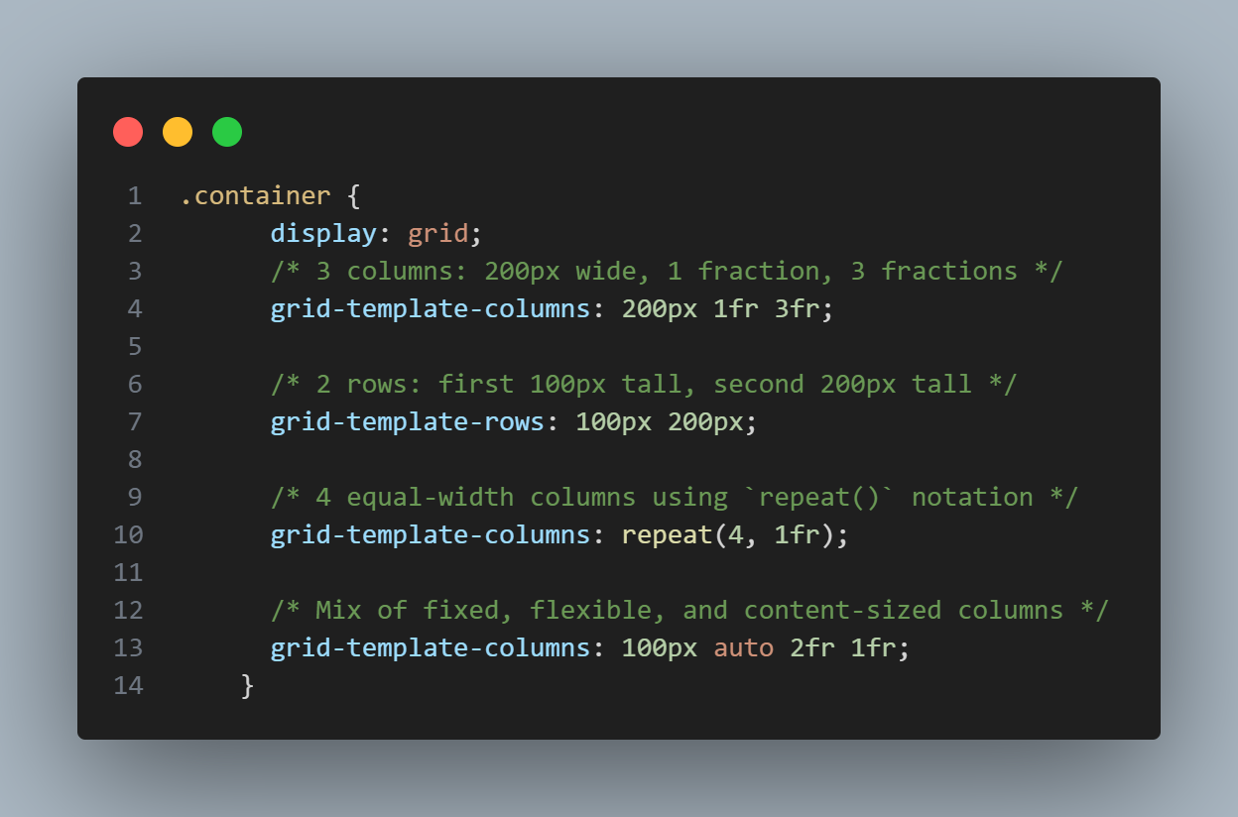
Examples

Slide 6
Defining the Grid (Container Properties)
grid-templates-areas
This property provides a visual way to define your grid layout. You give names to areas and then specify where they are on the grid.
How it works:
Define area names in the container.
Assign items to these areas.

Slide 7
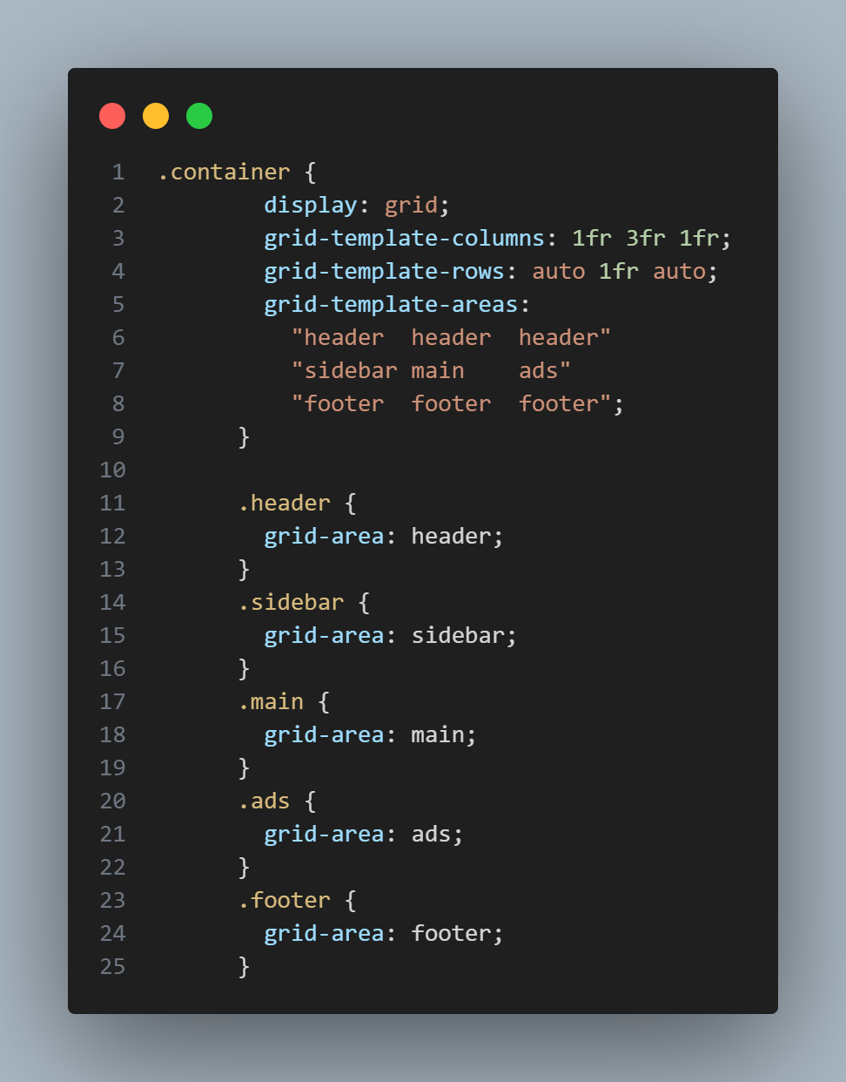
Examples

Slide 8
Cont’d
gap (formerly grid-gap)
A shorthand property to set the spacing between grid items. It's a major advantage over other layout methods.
row-gap: Space between rows
column-gap: Space between columns
gap:<row gap> <column gap>

Slide 9
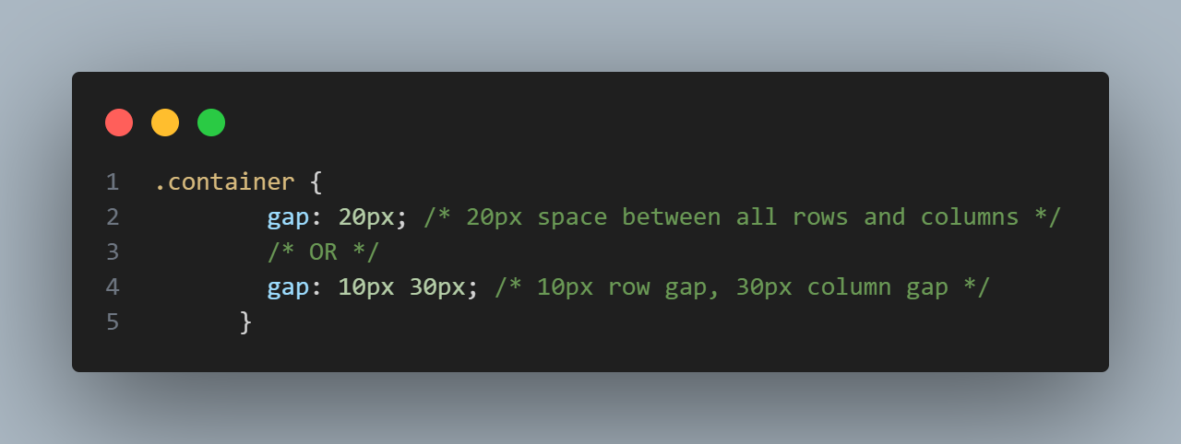
Examples

Slide 10
Placing items (Item Properties)
You can manually place items by specifying which grid lines they start and end at.
Line-Based Placement
grid-column-start: Which vertical line to start at.
grid-column-end: Which vertical to end at.
grid-row-start: Which horizontal line to start at.
grid-row-end: Which horizontal line to end at
grid-column: <start-line> / <end-line>
grid-row: <start-line> / <end-line>

Slide 11
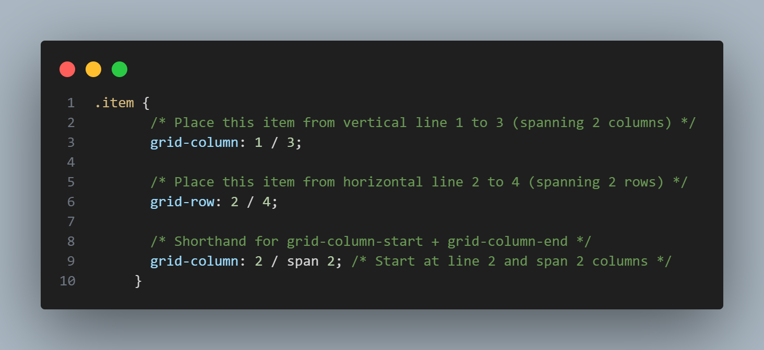
Cont’d

